Slide 1
Image De-Noising by
Wavelet Transform
傅思維

Slide 2
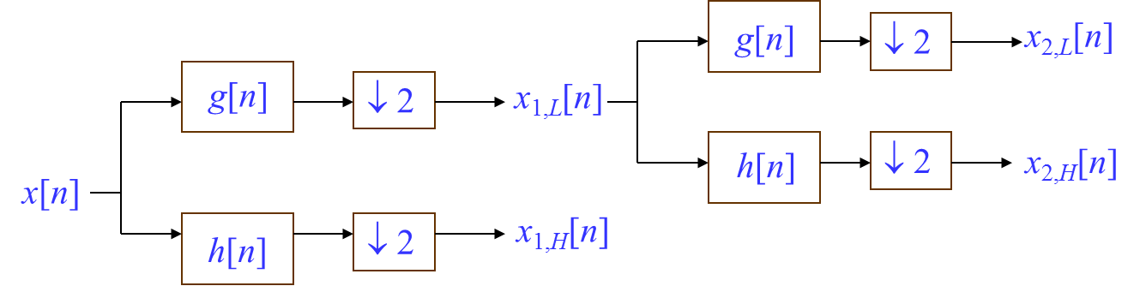
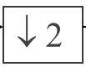
Introduction to Wavelet transform
How to implement?
g[n]: low pass filter h[n]: high pass filter
:down sampling

Slide 3
Introduction to Wavelet transform
Different sub-bands:
Fig. 2 (a) One level and (b) two level 2-D DWT.

Slide 4
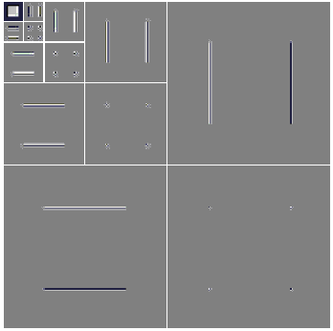
Introduction to Wavelet transform
1. Localized both in time (space) and frequency domain.
2. Multiresolution analysis (MRA).
Ex:

Slide 5
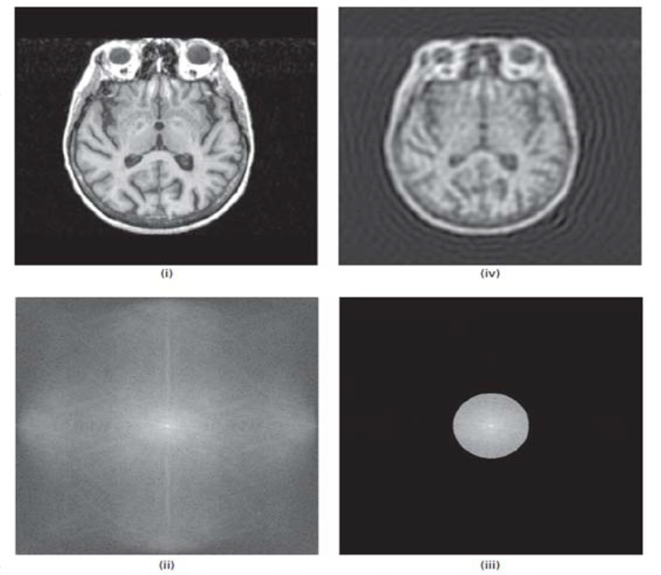
Why wavelet?
Traditional Fourier transform:

Slide 10
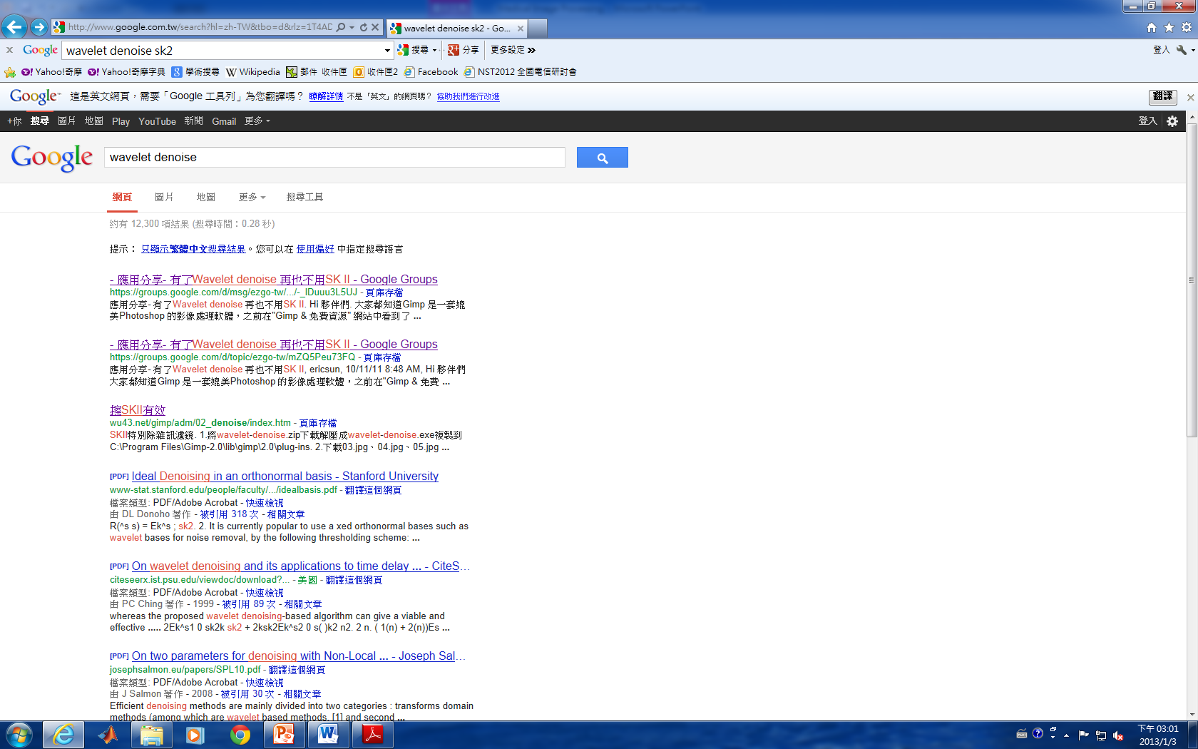
Why wavelet?

Slide 11
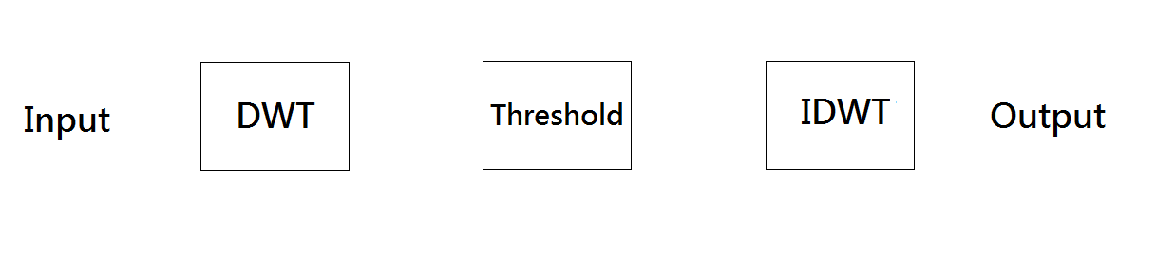
Flowchart of wavelet de-noising:
1. Perform the DWT on the noisy image to obtain sub-bands.
2. Threshold all high frequency sub band coefficients using
certain thresholding method.
3. Perform the inverse DWT to reconstruct the de-noised Image.

Slide 12
Two thresholding methods:
Hard-thresholding:
f_h(x) = x if abs(x) ≥ λ (1)
= 0 otherwise
Soft-thresholding:
f_s(x) = x −λ if x ≥ λ
= 0 if x < λ (2)
= x +λ if x ≤ −λ

Slide 13
Two thresholding methods:
(a) (b)
Fig. 3 (a) Hard-thresholding and (b) soft-thresholding

Slide 14
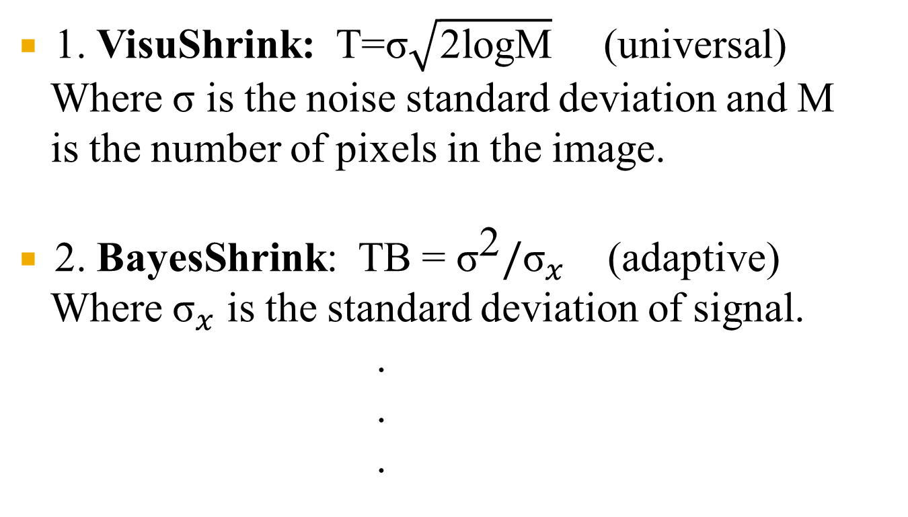
Threshold determination
1. VisuShrink: T=σ$\sqrt{\text{2}\text{logM}}$ (universal)
Where σ is the noise standard deviation and M
is the number of pixels in the image.
2. BayesShrink: TB = ${\text{σ}}^{\text{2}}/{\text{σ}}_{x}$ (adaptive)
Where ${\text{σ}}_{x}$ is the standard deviation of signal.
.
.
.

Slide 15
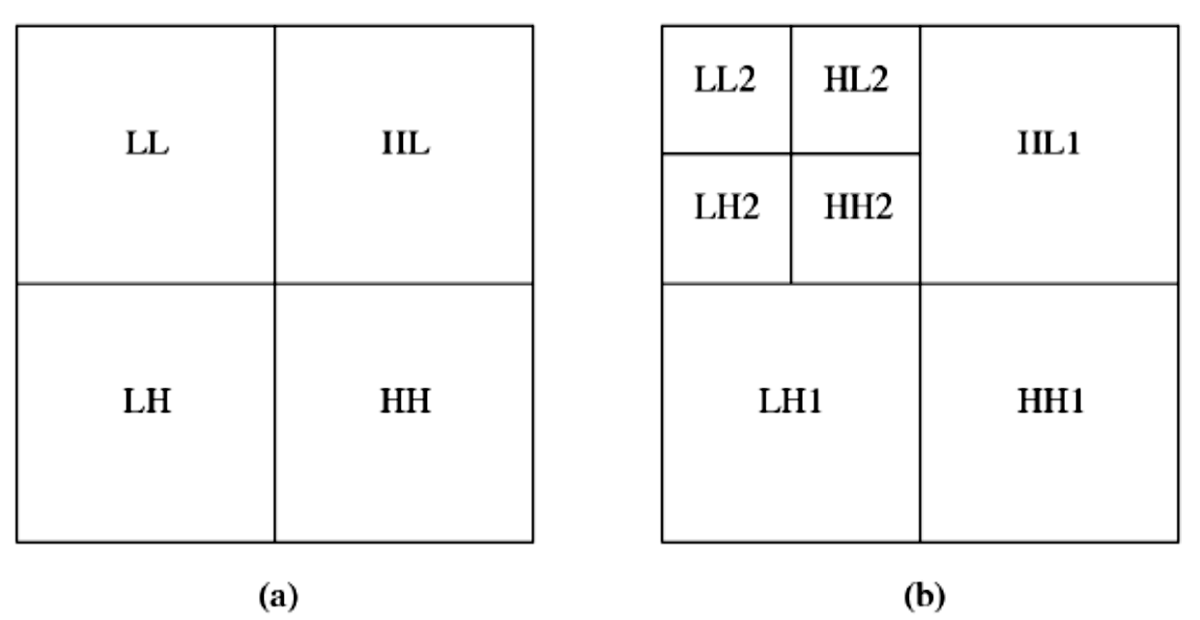
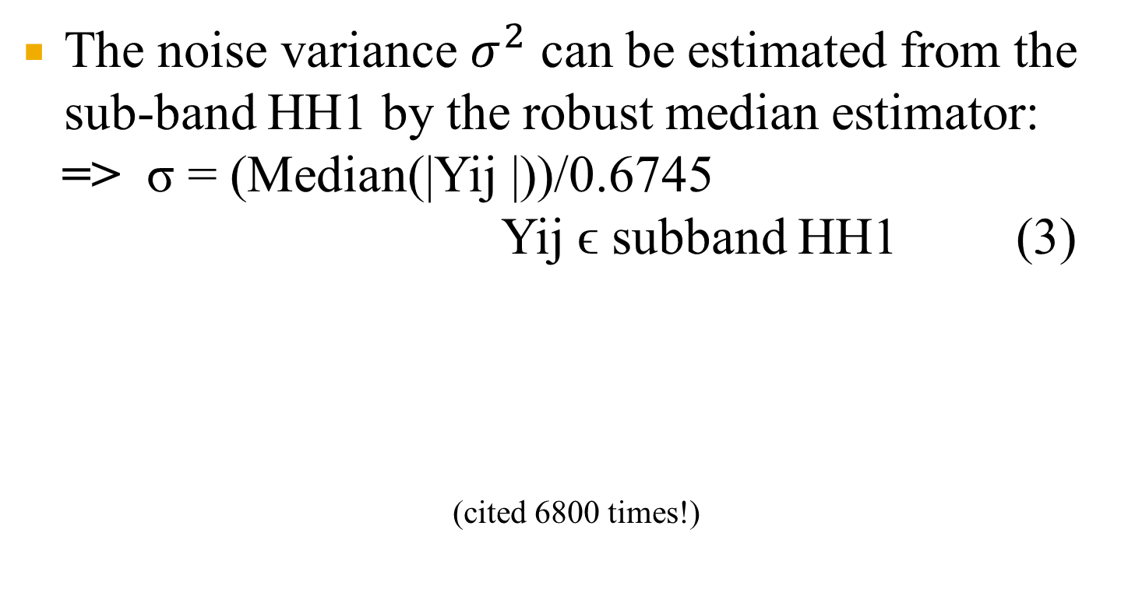
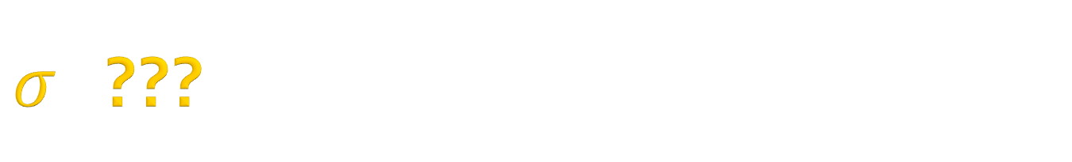
$σ$ ???
The noise variance $σ^{2}$ can be estimated from the sub-band HH1 by the robust median estimator:
=> σ = (Median(|Yij |))/0.6745
Yij ϵ subband HH1 (3)
(cited 6800 times!)
D. L. Donoho and I. M. Johnstone, “Ideal spatial adaptation via wavelet shrinkage,” Biometrika, vol. 81, pp. 425–455, 1994.

Slide 16
Ex:
0 -> 2.3743
10 -> 10.5174
20 -> 20.1602
30 -> 30.2146

Slide 17
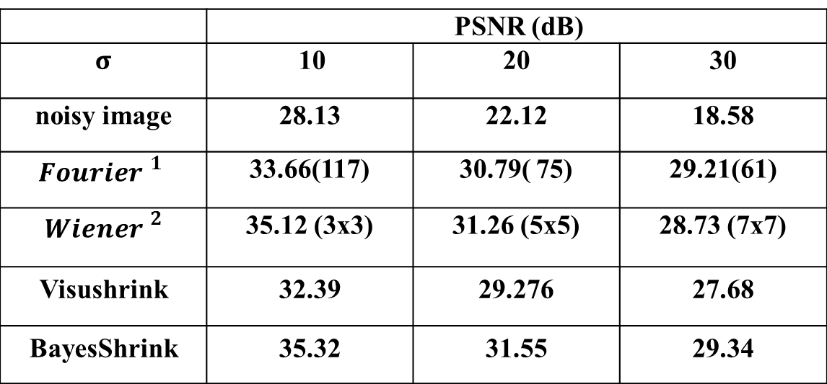
Additive white Gaussian noise
Table I: PSNR of test image corrupted by AWGN
 | PSNR (dB)
$$σ$$ | 10 | 20 | 30
noisy image | 28.13 | 22.12 | 18.58
$${Fourier }^{1}$$ | 33.66(117) | 30.79( 75) | 29.21(61)
$${Wiener }^{2}$$ | 35.12 (3x3) | 31.26 (5x5) | 28.73 (7x7)
Visushrink | 32.39 | 29.276 | 27.68
BayesShrink | 35.32 | 31.55 | 29.34
Cheat!
1.The standard deviation of the Gaussian lowpass filter is chosen until the best result appears.
2.The window size of Wiener filter is chosen until the best result appears (shown in the parentheses).

Slide 18
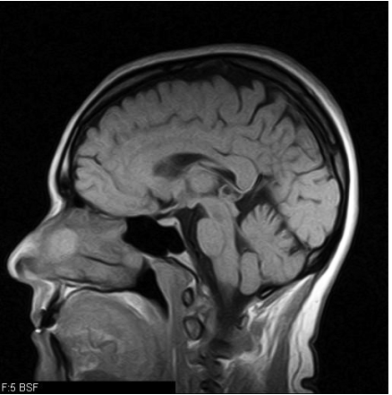
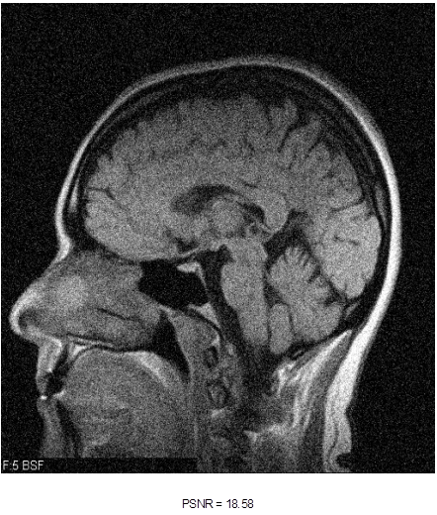
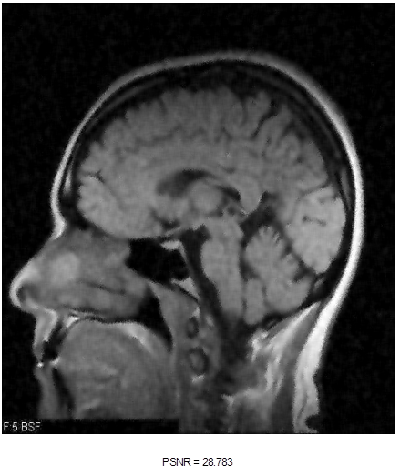
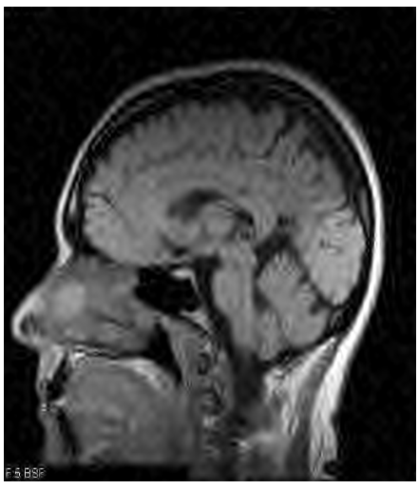
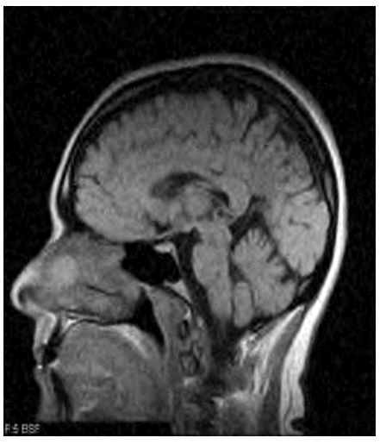

Slide 19
Q & A

Slide 20
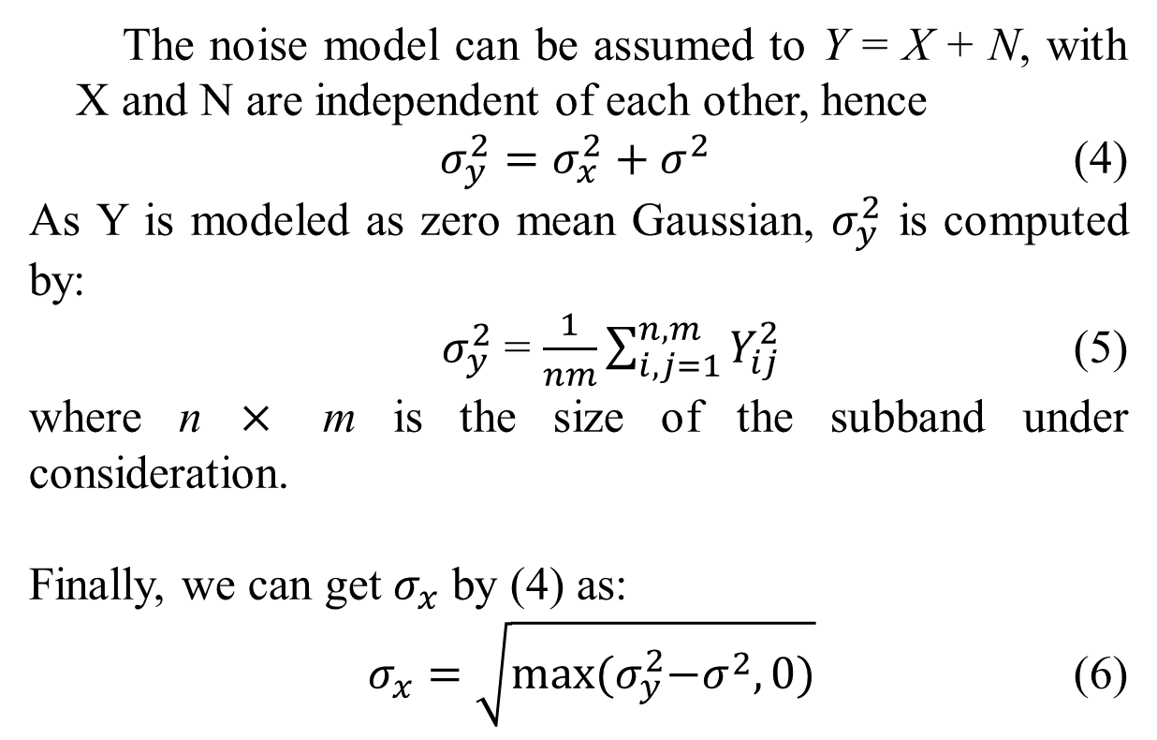
Appendix
The noise model can be assumed to Y = X + N, with X and N are independent of each other, hence
$σ_{y}^{2}=σ_{x}^{2}+σ^{2}$ (4)
As Y is modeled as zero mean Gaussian, $σ_{y}^{2}$ is computed by:
$σ_{y}^{2}$ = $\frac{1}{nm}\sum_{i,j=1}^{n,m}{Y_{ij}^{2}}$ (5)
where n $×$ m is the size of the subband under consideration.
Finally, we can get $σ_{x}$ by (4) as:
$σ_{x}=\sqrt{\max{{(σ}_{y}^{2}−σ^{2},0)}}$ (6)

